Slide 1
College Bazaar
Kelly Weber, James Moir, Patrick Isho, Trevor Drozd, Spenser Grzadzinski, Alissa Barnard

Slide 2
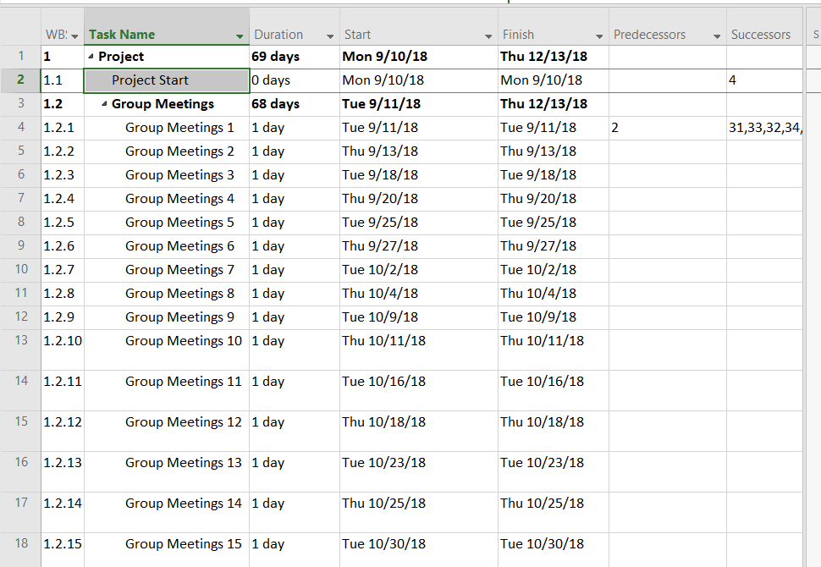
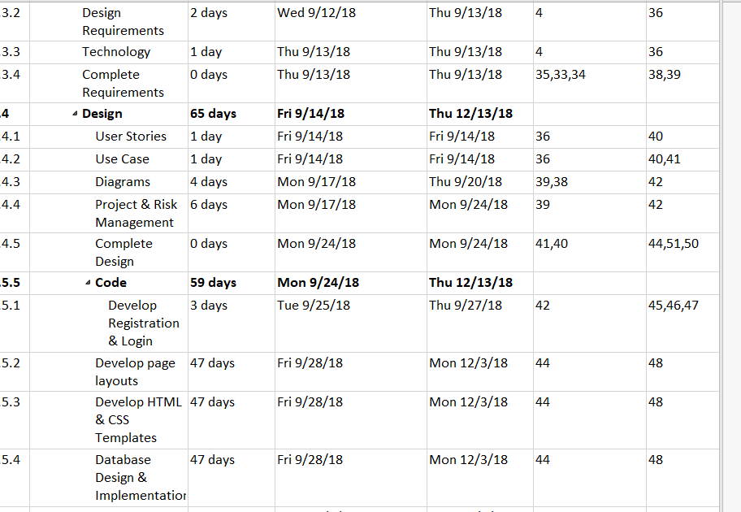
MICROSOFT PROJECT

Slide 3
USER STORIES
User Story #1. As a user I can register on the website to become a subscriber, and I can trust that my registration information shall be stored in a database.
User Story #2. As a user I can login to the website.
User Story #3. As a user I shall have the ability to post and remove products, services, and comments in forums to the website.
User Story #4. As a user I shall have the ability to send and receive emails to and from other users.
User Story #5. As a user I should have security of my password stored into the database.
User Story #6. As a user I should have the ability to access a live environment that is not affected by the work environment.
User Story #7. As a user I should have access to the legal section and terms of use.

Slide 4
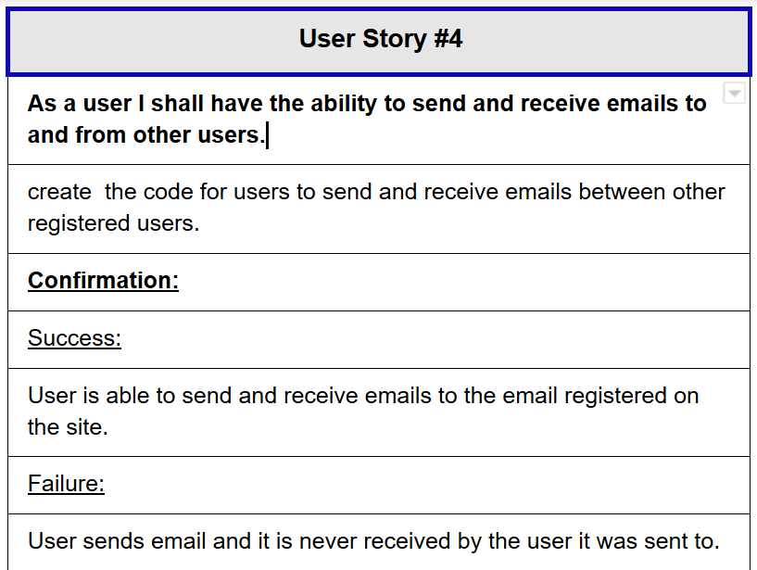
USER STORY DESCRIPTION

Slide 5
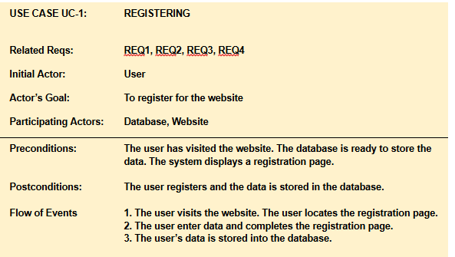
USE CASE DESCRIPTION

Slide 6
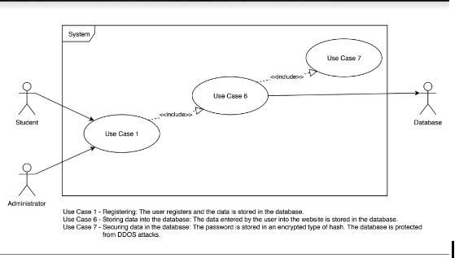
USE CASE DIAGRAM

Slide 7
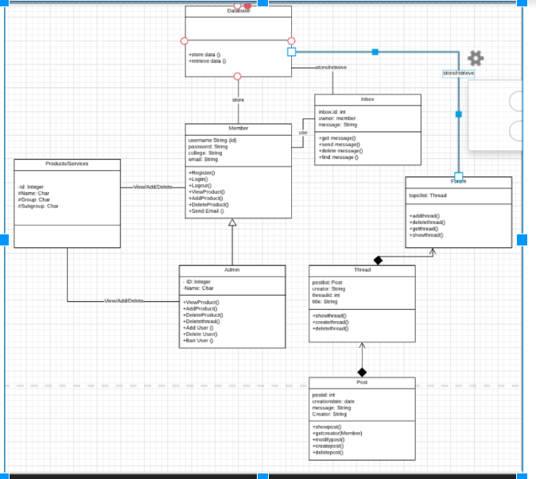
CLASS DIAGRAM

Slide 8
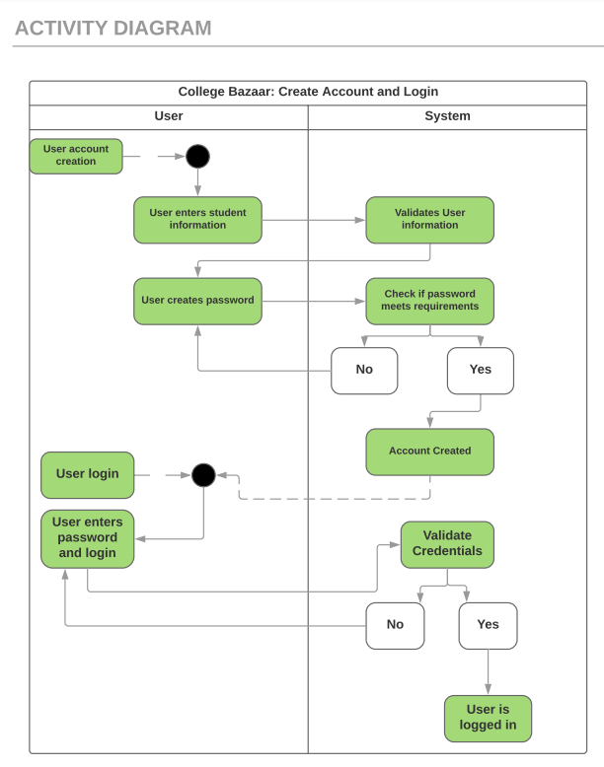
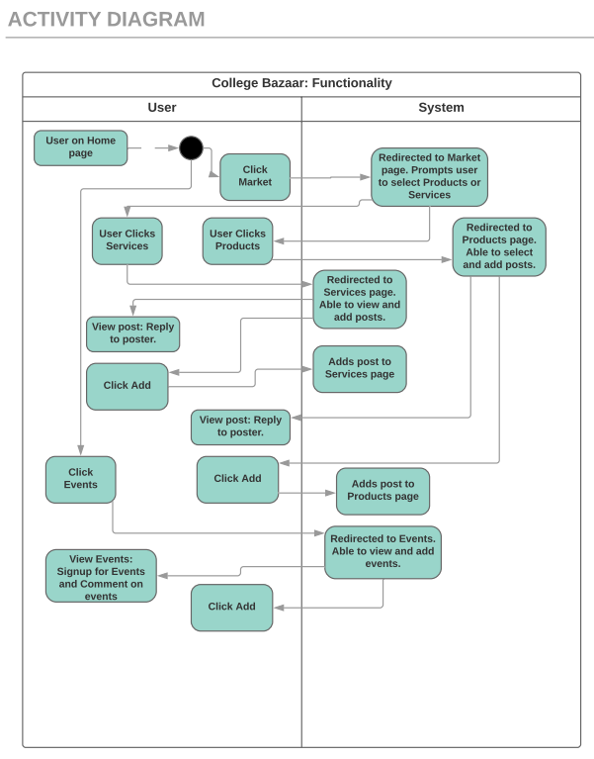
ACTIVITY DIAGRAM

Slide 9
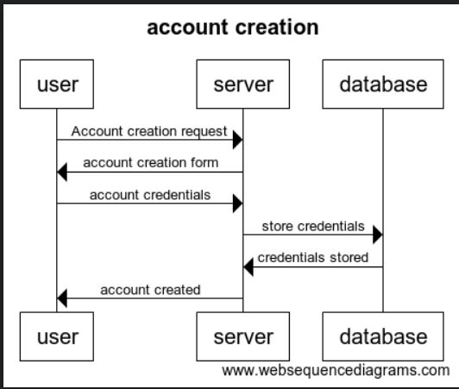
SEQUENCE DIAGRAM

Slide 10
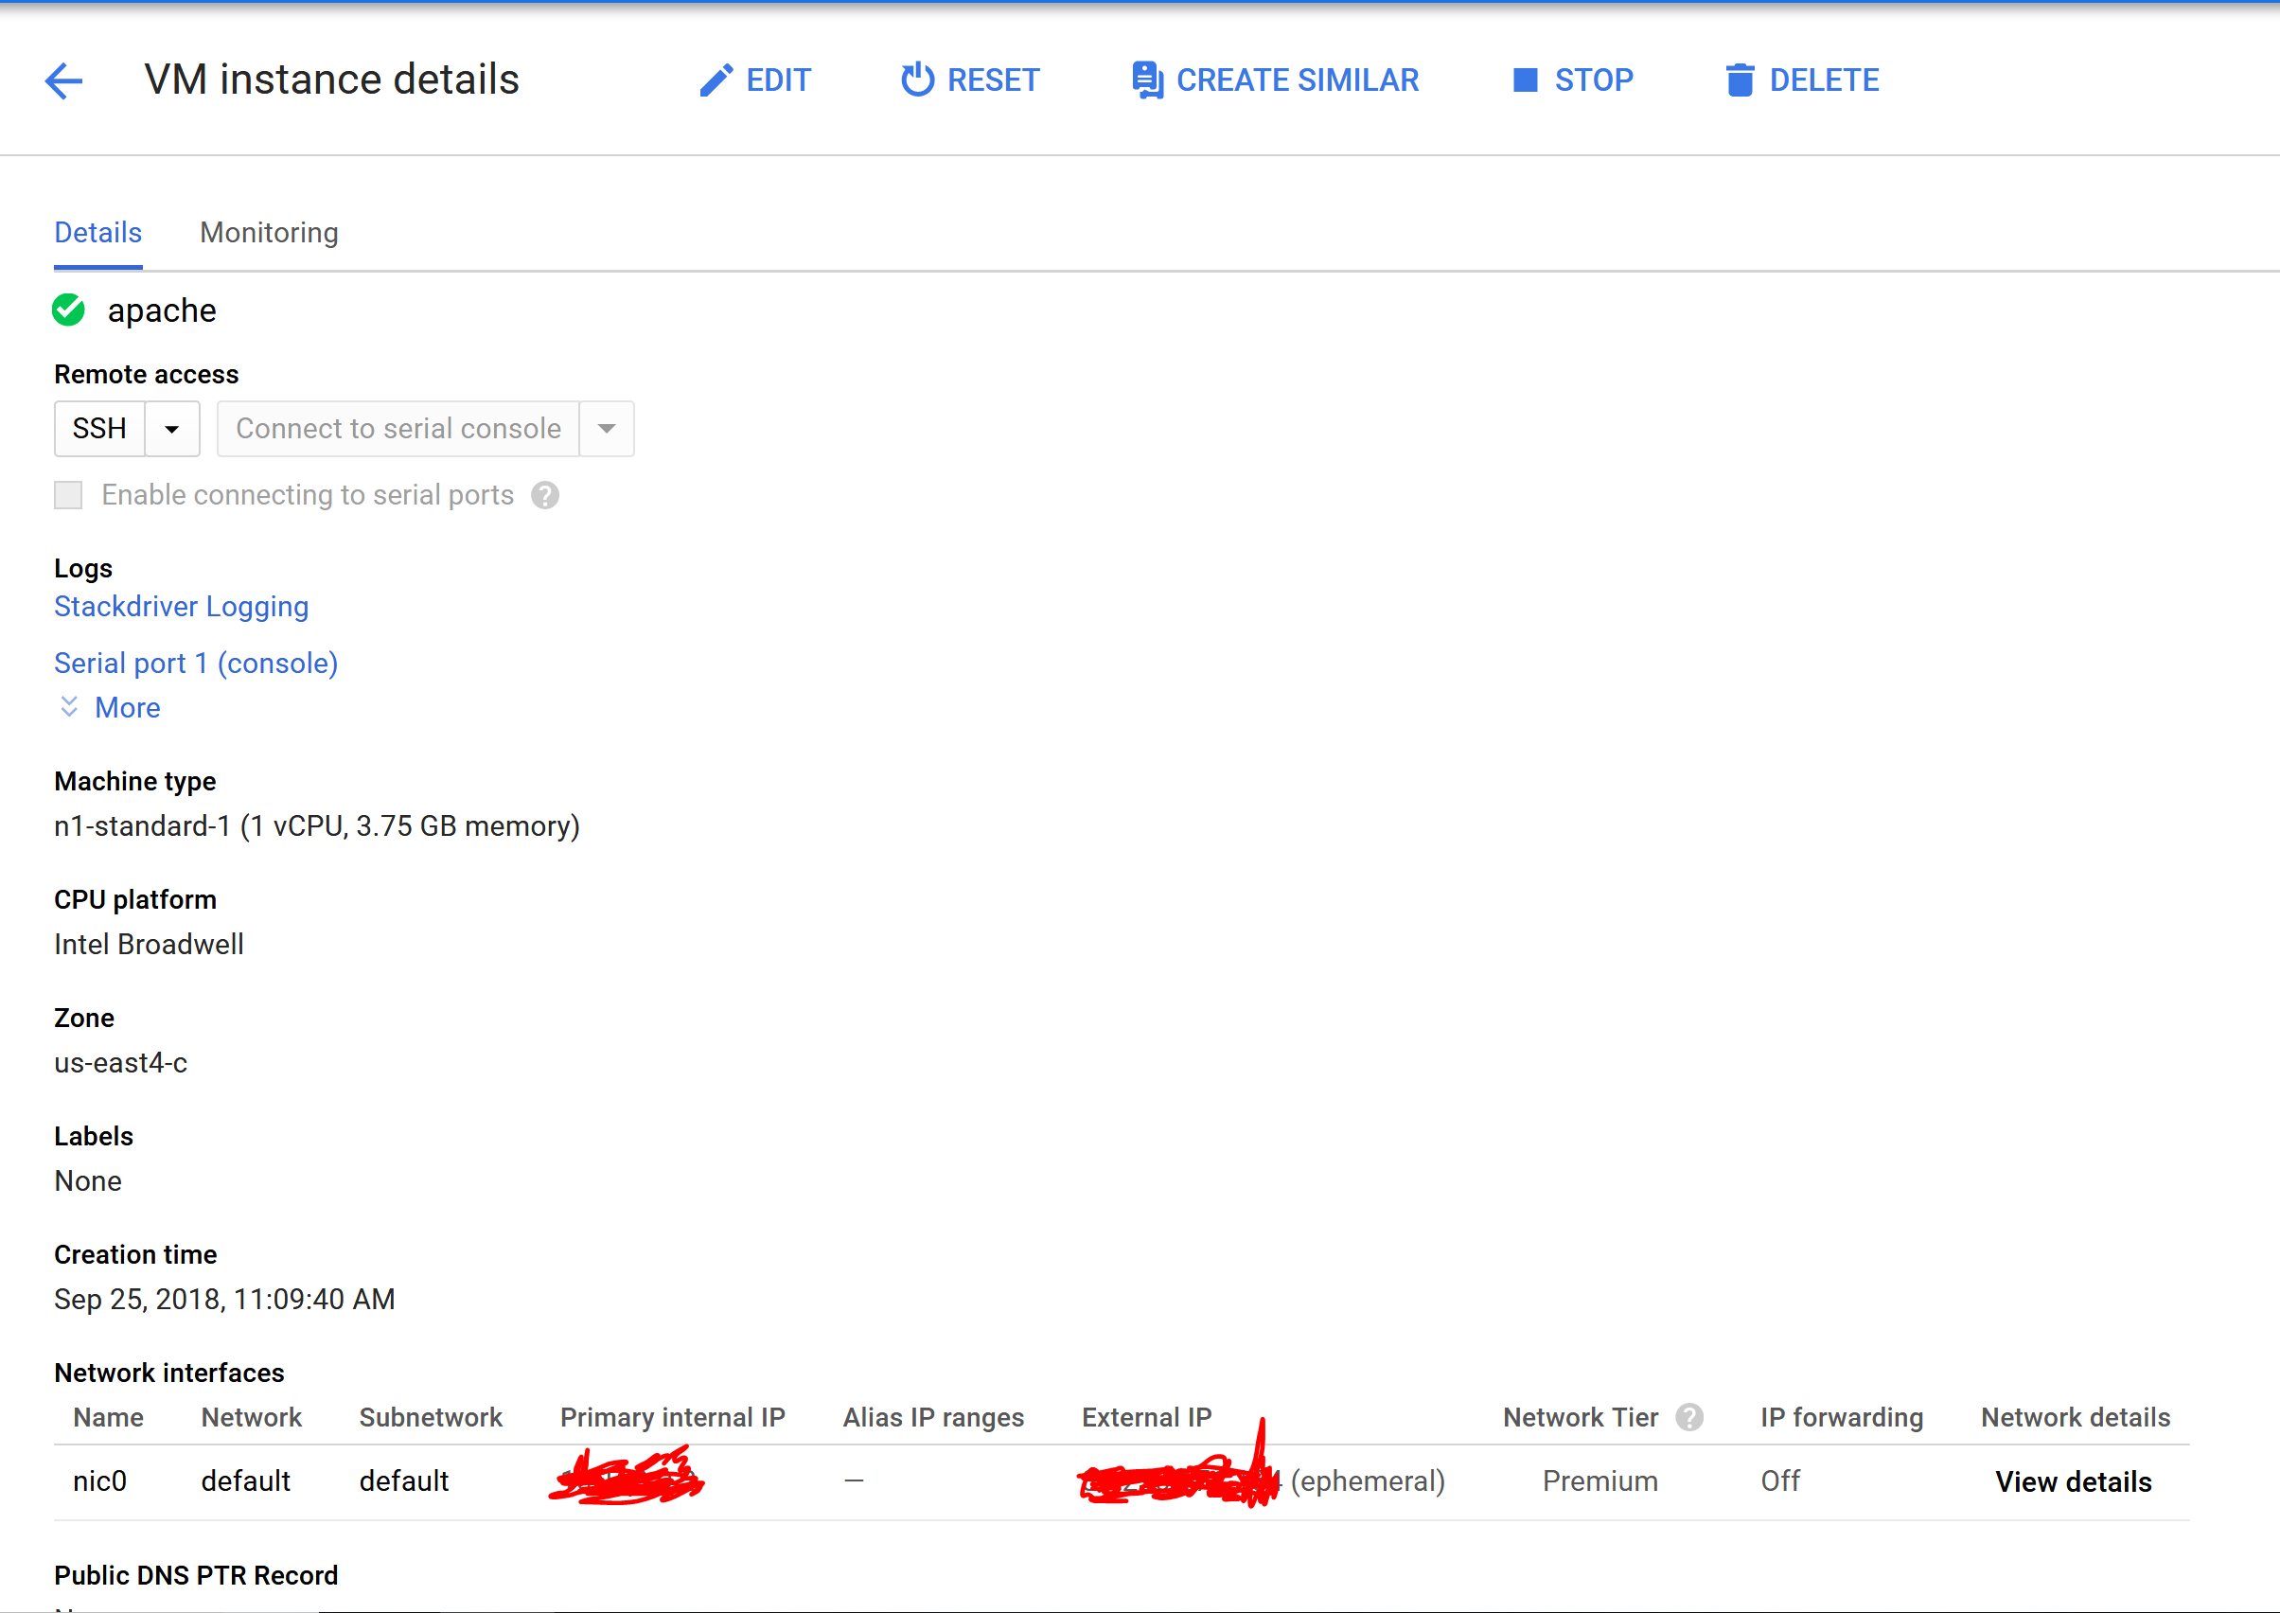
BACKEND DEVELOPMENTS
Debian 9 VM has been installed and is in the process of configuration
20GB dynamic memory and expandable
Located in google east servers

Slide 11
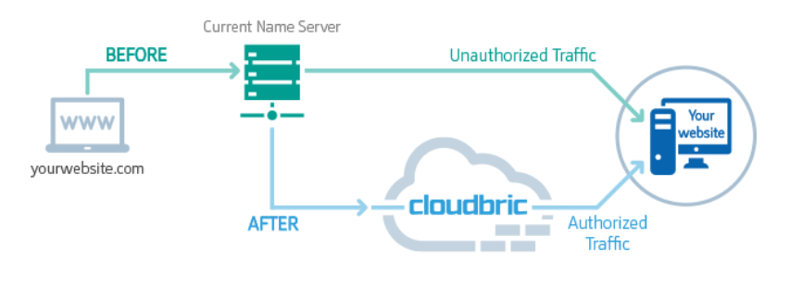
CLOUDBRIC
Comprehensive web security
Web application firewall
DDoS protection
SSL Certificate

Slide 12
CONCLUSION
Development is along schedule with Sprint plan
Risk mitigation has been successful, development on Cloud9 for general collaboration
For the next Sprint we’ll be adapting our website to the PhoneGap Framework in order to have a nicer looking finished product

Slide 13
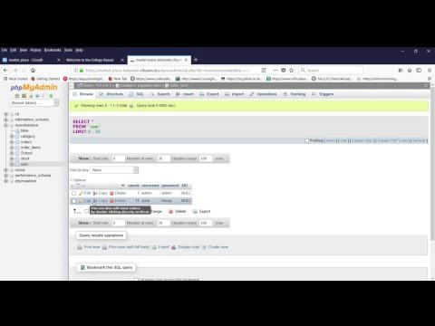
DEMO

